Slide 1

January 6, 2016
The 4 Rules of Simple Design
Applied to complex software
Notes:
Headline: Georgia, 47pt
Subhead: Georgia, 32pt
Right Aligned
Note: Feel free to adjust sizing to fit
Note: Delete “Confidential” if not needed

Slide 2

This is how we roll
Notes:
- Ruby/Rails
- Pair Programming
- TDD
- Remote Development

Slide 3
Complex Products != Complex Designs
“
Simple software design enables simple humans to maintain immensely complex systems.

Slide 4
What are the 4 rules?
Tests Pass
Expresses Intent
No Duplication (DRY)
Small
Understanding the 4 Rules of Simple Design – Corey Haines

Slide 5
It’s about humans
Tests Pass (gives me confidence)
Expresses Intent (informs me)
No Duplication (avoids confusion)
Small (fits in my head)
Beware of geniuses

Slide 6
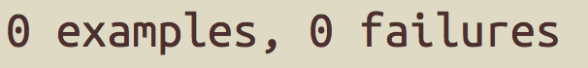
TESTS PASS

Slide 7
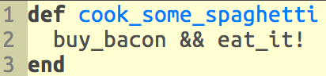
EXPRESSES INTENT

Slide 8
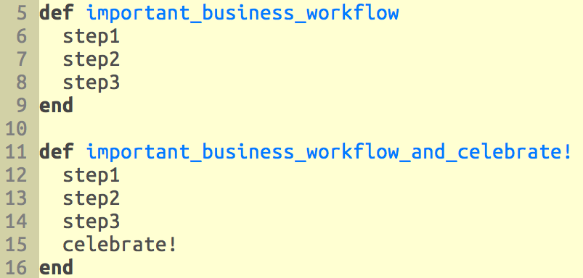
No Duplication (DRY)

Slide 9
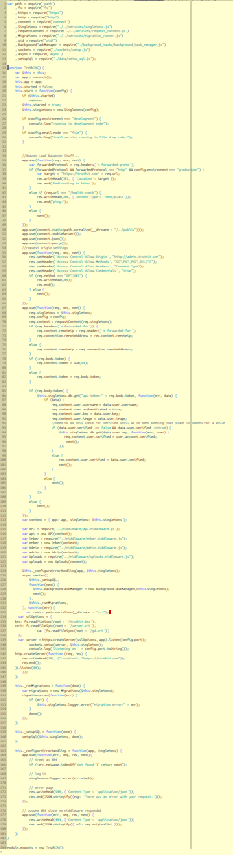
SMALL

Slide 10

Building a Complex Product
Day 1

Slide 11
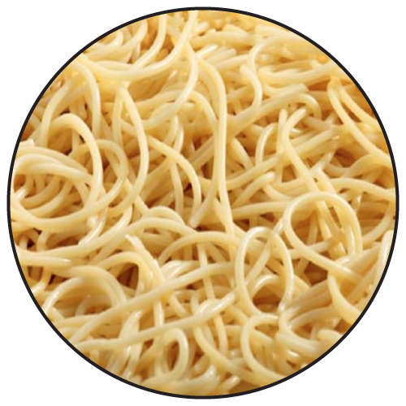
Building a Complex Product
Is this Your Future?

Slide 12
Applying the Rules
Breaking down our spaghetti problem into smaller spaghetti problems.
Notes:
––

Slide 13
Apply the Rules
Organization
Systems
Code

Slide 14
Applying the Rules - Organization

Slide 15
Applying the Rules - Systems

Slide 16
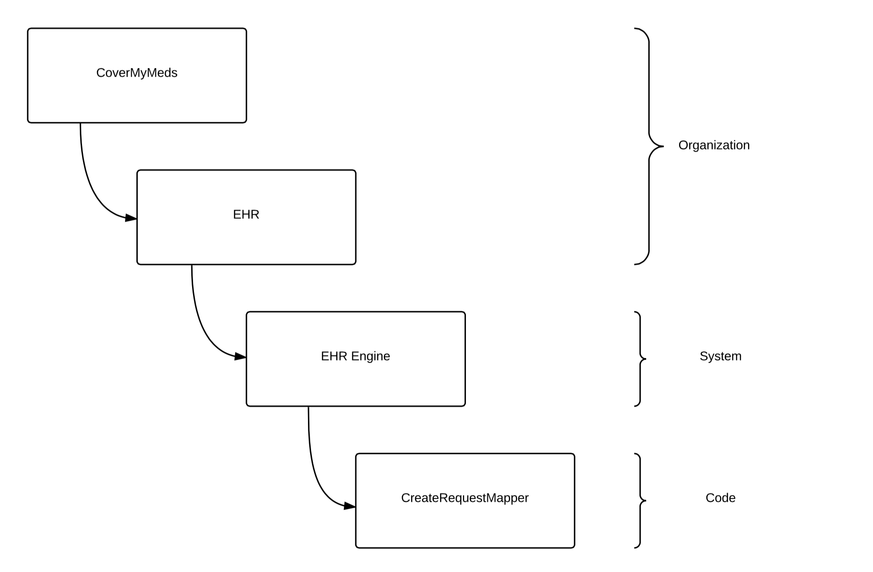
Applying the Rules - Code
Notes:
––

Slide 17
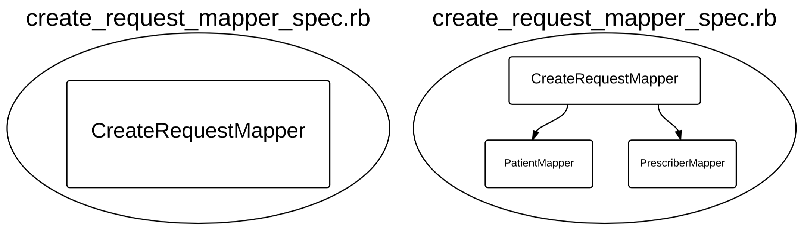
Applying the Rules – Passes Tests
Notes:
––

Slide 18
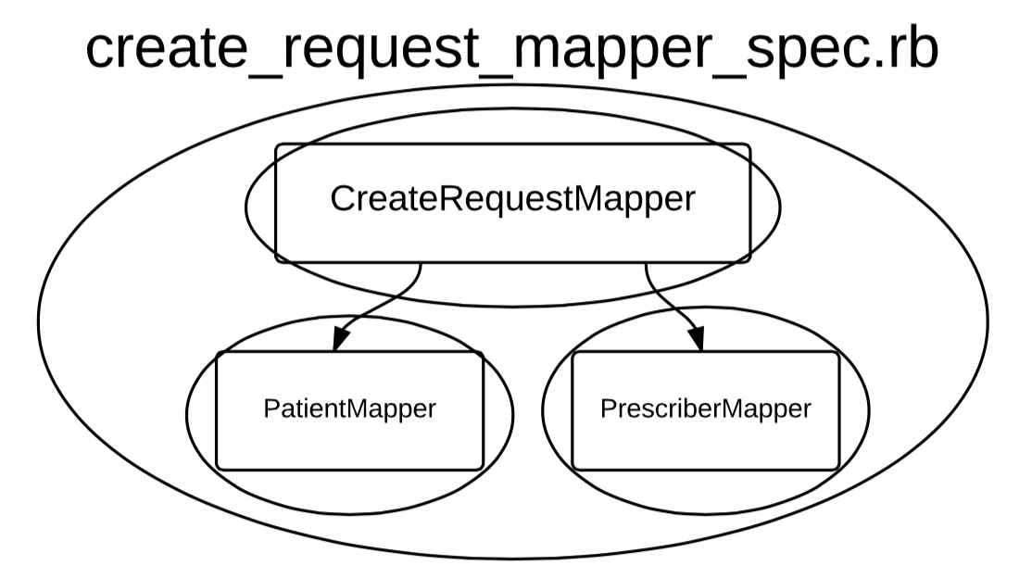
Applying the Rules – Passes Tests
Chasing the Implementation
Notes:
––

Slide 19
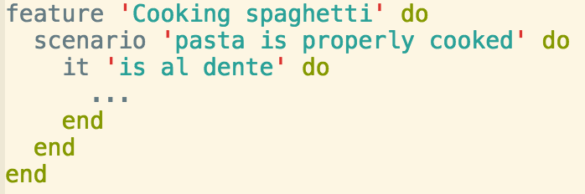
What does that even mean?
Applying the Rules – Passes Tests
Think about tests in advance and use them to help define ‘done’

Slide 20
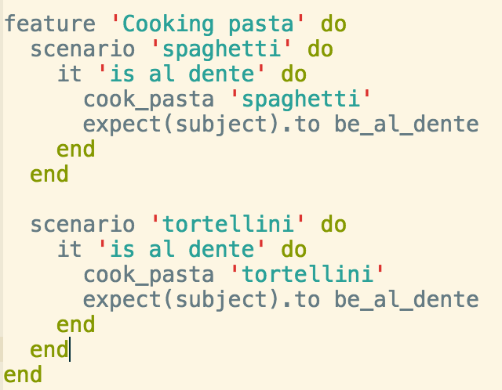
What does that even mean?
Applying the Rules – Passes Tests
Make your tests as adaptable as your code

Slide 21
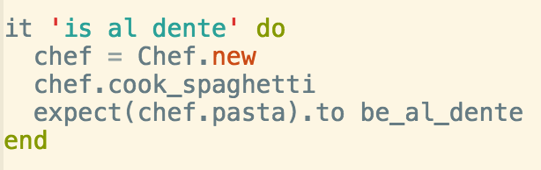
What does that even mean?
Applying the Rules – Passes Tests
Make your tests readable so you know you are testing the right things!

Slide 22
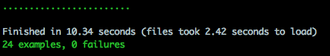
What does that even mean?
Applying the Rules – Passes Tests
Provide security to Future Developers
If you are a Future Developer, don’t break anything!

Slide 23
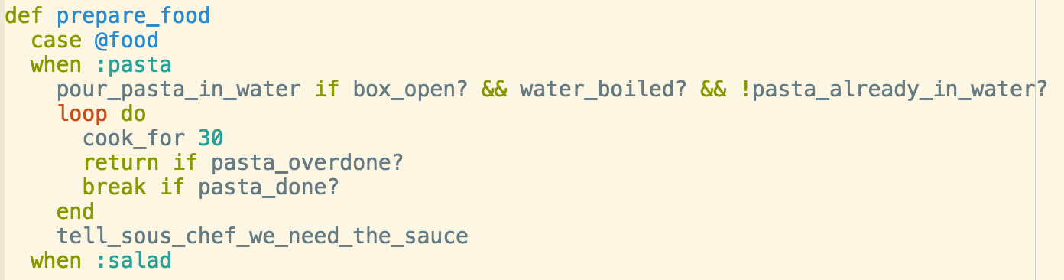
What does that even mean?
Applying the Rules – Passes Tests
If it’s hard to test, you built it wrong!

Slide 24
You don’t have to TDD, but it helps!
Applying the Rules – Passes Tests

Slide 25
Unit tests…
Applying the Rules – Passes Tests
Provide security to future developers
Help you understand what you are building
Help you make better design decisions while building

Slide 26
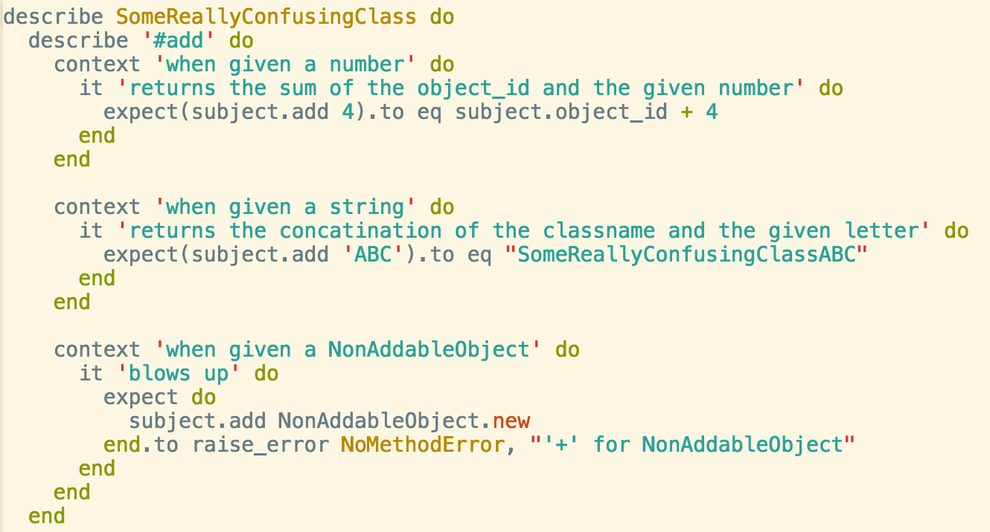
Unit tests…
Applying the Rules – Passes Tests

Slide 27
Function tests…
Applying the Rules – Passes Tests
Tell you when you’re done
Reassure everybody that a change in X did not affect Y
Today’s function test is tomorrow’s regression test
Are often more resistant to change than unit tests
We change implementation way more than we change functionality

Slide 28
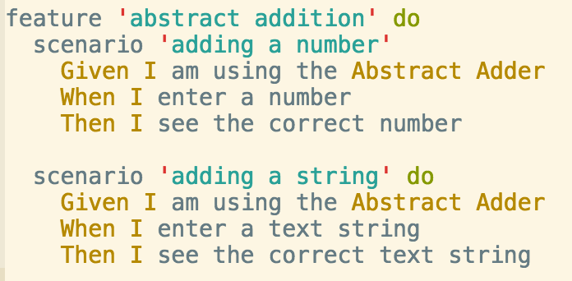
Function tests…
Applying the Rules – Passes Tests

Slide 29
We have numerous unit tests that serve a variety of purposes
Applying the Rules – Passes Tests
They tell us our code works
First line of defense!
The help us understand what our code does and how to use it
The identify the limitations of our current design

Slide 30
We have numerous function tests that are used in multiple ways
Applying the Rules – Passes Tests
They serve as a regression suite we can run to make sure there are no unexpected changes
They let us know we designed the right thing
They tell us our product works
Last line of defense!

Slide 31
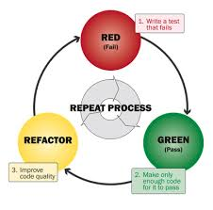
Ensuring All Tests Pass - Development
Applying the Rules – Passes Tests
We use TDD (test driven development)
Write tests, watch them fail, add enough code to make them pass

Slide 32
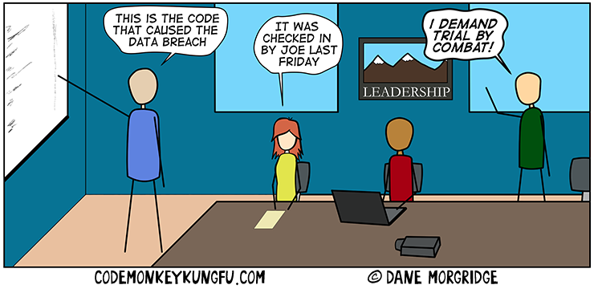
Ensuring All Tests Pass – Development
Applying the Rules – Passes Tests
The core functionality of each class is covered by a set of unit tests
Don’t forget negative test cases
These are assessed as part of the code review, just like any
code changes

Slide 33

Ensuring All Tests Pass - Development
Applying the Rules – Passes Tests
We make it a responsibility to keep our test suites green
If you see a failing test, fix it!

Slide 34
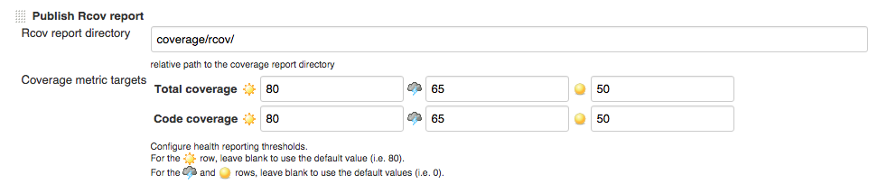
Applying the Rules – Passes Tests
Ensuring All Tests Pass - Development
We make it a responsibility to keep our test suites full
Run code coverage metrics, and aim for 80% or higher
Our CI jobs will fail builds that don’t meet the code coverage standards

Slide 35
Ensuring All Tests Pass - Deployment
Applying the Rules – Passes Tests
We run all unit tests prior to declaring our work done
We run full regression and function testing against a test environment
We run all function tests and a subset of regression tests post-deploy against production

Slide 36
Ensuring All Tests Pass – Maintenance
Applying the Rules – Passes Tests
We have a suite of system integration tests that runs daily through a CI job
Sometimes it will find bugs inserted by other teams that they did not catch!

Slide 37
Ensuring All Tests Pass – Maintenance
Applying the Rules – Passes Tests
We have a suite of system integration tests that runs daily through a CI job
Sometimes it will find bugs inserted by other teams that they did not catch!

Slide 38
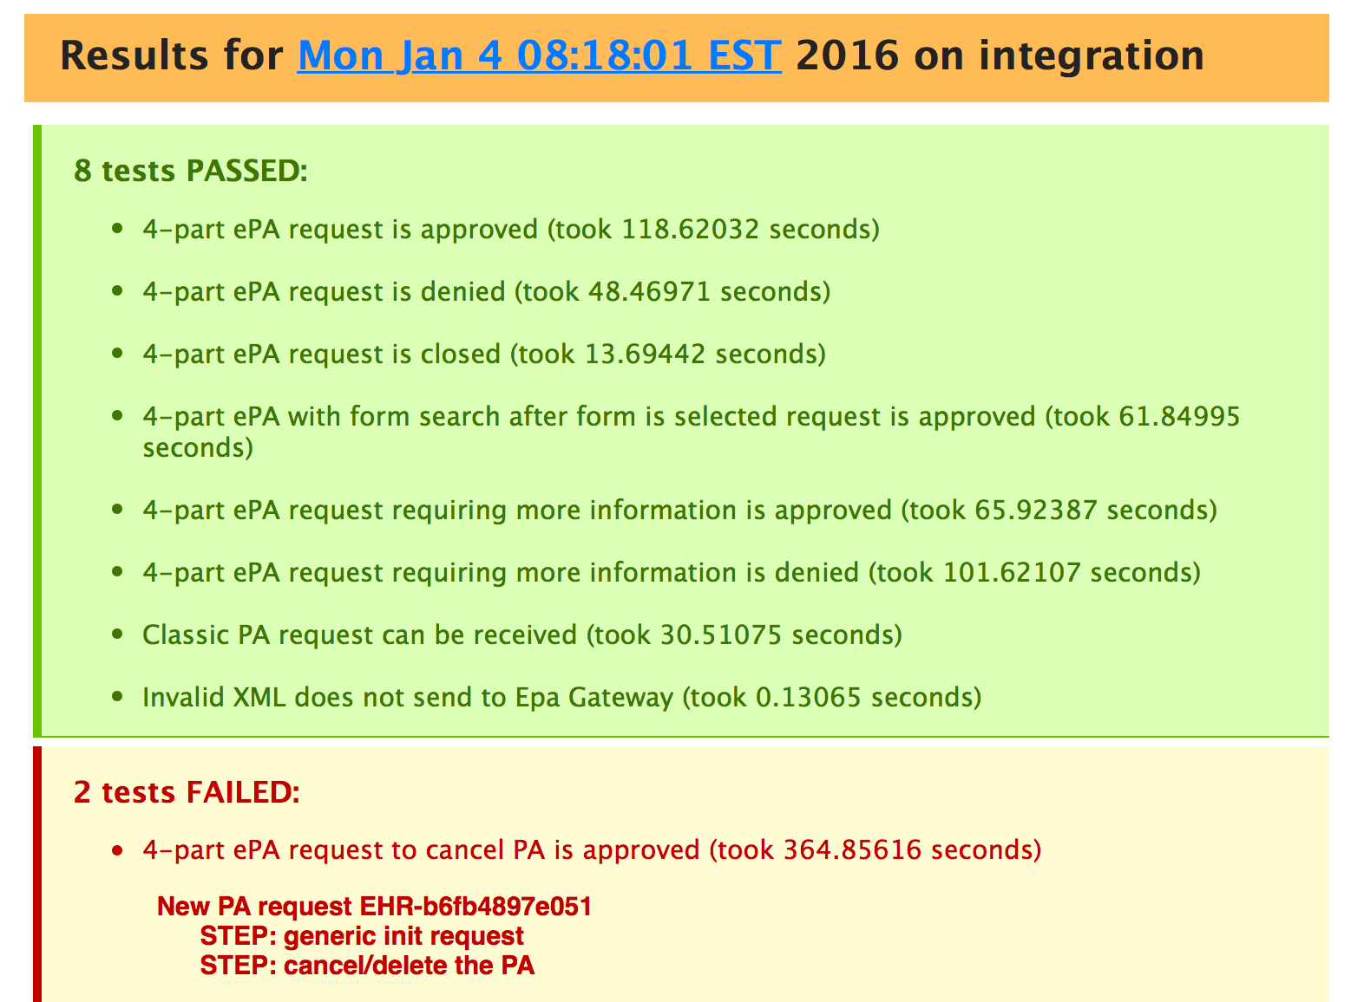
Ensuring All Tests Pass – Maintenance
Applying the Rules – Passes Tests
* Taken from an actual email, sent daily with the test results.

